Slide 1

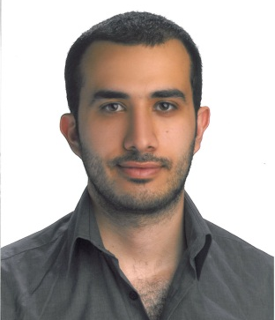


Ahmad Assaf 2nd Year PhD Candidate
A Framework for Enriching Business Intelligence with Semantics
Multimedia Semantics Group
Supervisor: Raphaël TRONCY
Notes:
Hello, my name is Ahmad Assaf, and I am a CIFRE student working under the supervision of Raphaël Troncy in the Multimedia Semantics Group and SAP Labs France in the Business Intelligence Department. I have just started my second year and I am currently working towards building a framework that will help enriching business intelligence with linked data and semantics.

Slide 2






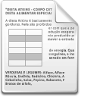






Problem Definition
Enterprise Data
Social Media Feeds
Business Intelligence Analysis
Sensor Data
Governmental Data
ERP - -
PRM
CRM
Distributed sources with heterogeneous data formats and terminologies
Complex data models
Different storage models
Noisiness (duplications, inconsistencies)
Notes:
Companies have traditionally performed business analysis based on transactional data stored in legacy relational databases. External source like social media feeds, weblogs, sensor data, or data published by governments or international organizations are nowadays becoming increasingly available.
Data coming from these resources can have several problems due to the heterogeneity of the data formats, models and so on.

Slide 3
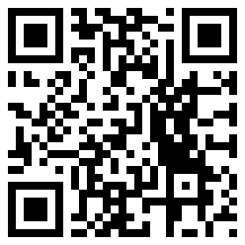
Research Direction
Mining
External Catalogue
Integration
Refining
Exploration
Matching
Analysis
Mapping
NER, Pattern matching … etc.
Shared Data source representation
Semantic model and mapping mechanisms
DCAT Crawler
RUBIX V1
Data Quality Framework
RUBIX V2
Yìngshè (Graph Mapper)
SNARC – A Semantic Social News Aggregator
Winner of the AI Mashup Challenge at ESWC 2013
Notes:
To reach our goal; we have identified four main steps.
Data mining process
Exploration and integration of data catalogues
Integration of data found in the catalogues with the ones in our internal systems
A refining step that takes user’s interaction and feedback into account
We have contributed to several steps in our plan and please come over to my poster session and feel free to ask further questions, thanks a lot and looking forward to answer your questions.
In the data mining step we try to semantically annotate our BI data; by using NER, pattern matching and so on.
To ensure proper integration between internal and external catalogues we need to have a shared data representation (DCAT); we want also to build a DCAT crawler that will be able to look into the datasets and provide detailed insights about the data itself. We also plan to extend DCAT with our proposed Data Quality Framework.
To achieve proper integration we need to have a semantic BI model and novel mapping mechanisms. We have contributed with an approach called RUBIX that was implemented as an Open Refine extension that tackles this issue. We are currently working on an enhanced user interface called Yingshe to ease the process of mapping instances or ontologies.

